Slide 1
Blind Assist Navigation System
RP25_012

Slide 2
Group members
IT21821486-Punchihewa A.S.G
IT21820946 – Weragala R.T.L
IT21826740 -K.D. Dilini
Supervisor
Dr. Dharshana Kasthuriarachchi

Slide 3
Background and Literature
Blind individuals face challenges in navigation, friend recognition, and reading Sinhala text.
Existing aids (white cane, GPS, cloud apps) are limited, costly, or internet-dependent.
Environment scanning & object detection are essential for safe mobility but missing in most low-cost tools.
Sinhala voice control in assistive tech is underdeveloped.
Sinhala OCR exists but lacks practical deployment.
Our system integrates:
Navigation & obstacle detection
Environment scanning & object recognition
Friend recognition
Sinhala voice commands (via Android app + mic)
Sinhala OCR
All processed on a Raspberry Pi microcontroller

Slide 4
Research problem and objectives
Problem
Blind individuals lack an affordable, real-time assistive system for:
Safe navigation & obstacle avoidance
Environment scanning & object detection
Friend recognition
Sinhala text reading through OCR
Sinhala-first voice control for hands-free operation
Existing solutions are costly, internet-dependent, or not localized for Sinhala users.
Objectives
Develop a Raspberry Pi–based assistive system with navigation, obstacle detection, and environment scanning.
Implement real-time friend recognition on-device.
Enable Sinhala voice command control using an Android app microphone.
Integrate Sinhala OCR for reading printed text.
Deliver an affordable, portable, and user-friendly solution for blind individuals

Slide 5
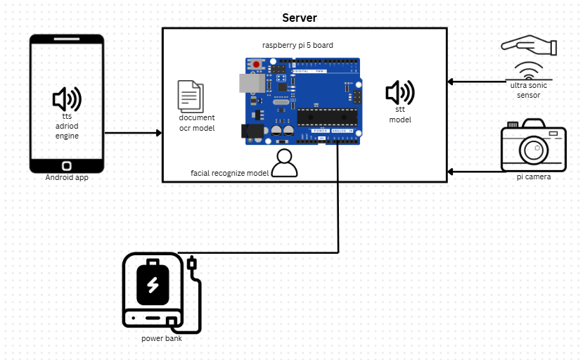
Overall system architecture

Slide 6
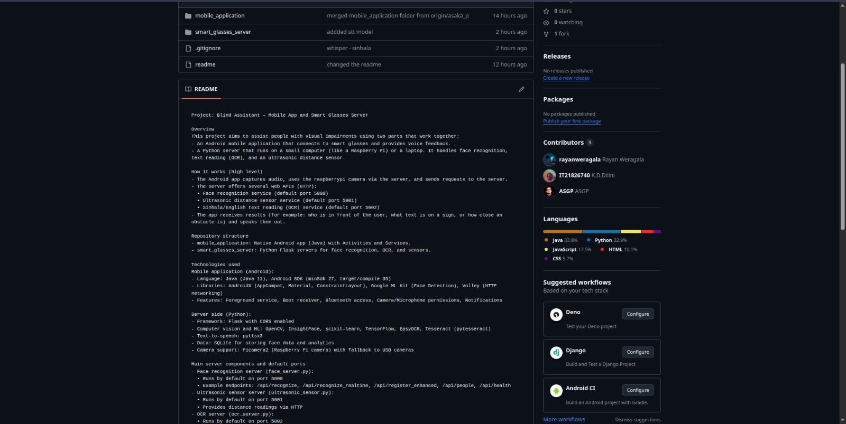
Version Controlling

Slide 7
Methodology
Voice Command (Sinhala STT)
Trained a Sinhala Speech-to-Text model from scratch for voice command recognition.
Face Recognition
Trained a facial recognition model to identify known persons/friends.
Text Reading (OCR)
Developed a Sinhala OCR model for character recognition.
Trained a classifier to identify types of documents.
Navigation & Obstacle Detection
Used ultrasonic sensors for distance measurement and obstacle alerts.
Applied pre-trained vision models for environment scanning & object detection.
Speech Feedback (Sinhala TTS)
Used Android native TTS engine for Sinhala voice output.
System Integration
All modules run on a Raspberry Pi microcontroller.
Android app microphone used for Sinhala voice input.

Slide 8
Device Components
Component | Model | Key Specifications | Cost (LKR)
Single-Board Computer | Raspberry Pi 5 | BoradCom BCM2712, 8GB RAM | ~RS 43,000
Camera Module | Raspberry Pi Camera Module 2 | 8MP , Sony IMX219 Sensor | ~RS 6500
Power Supply | Raspberry Pi 27W USB-C Power Supply | 5V/5A USB-C (official) | ~Rs. 5,500
Active cooler | Raspberry Pi 5 Active Cooler | Dual-fan + heatsink cooling | ~Rs. 3,000
Camera Cable(s) | Official Raspberry Pi Camera Cable | Ribbon cable (15– 30cm) | ~Rs. 1,000
Case | Official Raspberry Pi 5 Case | Plastic enclosure with cooling support | ~Rs. 4,500

Slide 9
Tech Stack
Software Component | Version | Purpose
Operating System | Raspberry Pi OS (64-bit) | Base OS for Raspberry PI
Machine Learning | TensorFlow Lite/Pytorch | Optimized model inference
Computer vision | OpenCV | Image processing, face detection
Backend Server | Flask (Python) | Restful API server
Mobile App | Java | Android mobile application
Database | SQLite | Local storage for face embeddings
Pre trained models | Whisper/base | To train Speach to text
Tessaract 5.5.0 | OCR | Extract text
InsightFace | Open-source Face recognition | Face recognition

Slide 10
Device Build
Raspberry Pi 5 microcontroller
Pi Camera
Ultrasonic sensor
Cooling system (fan and heatsink)
Protective casing for microcontroller and sensors
Android mobile application
Power Bank (5v)
Wi-Fi and Bluetooth connectivity

Slide 11

IT21821486 | Punchihewa A.S.G
BSc (Hons) Degree in Information Technology
(specialization in Information Technology)

Slide 12
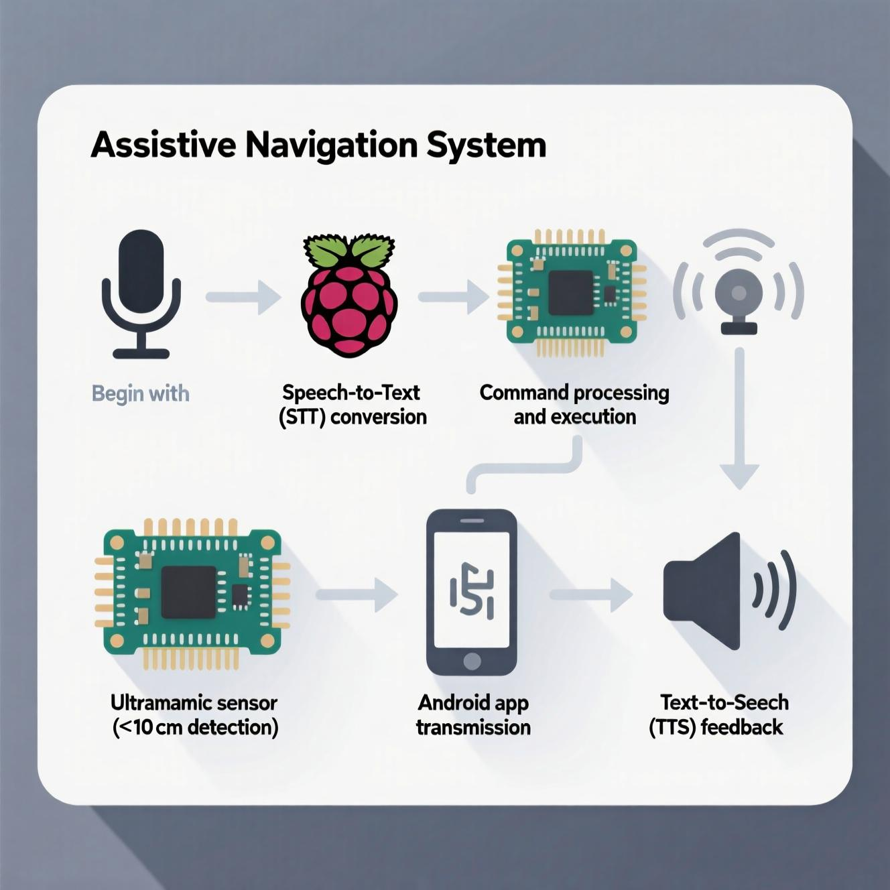
IT21821486 – Punchihewa A.S.G
Trained Sinhala speech to text model form scratch using public dataset
Develop Ultra sonic sensor circuit and integrate it to android app and micro controller to handle obstacle detection warning
Use android app text to speech for voice commands for user
Deployed and run on micro controller (edge device)
Build android app parts for sections
Model training
Used public dataset for model training (source - pnfo/sinhala-tts-dataset: High Quality Sinhala dataset for Text to speech algorithm training - specially designed for deep learning algorithms)
ID | New File Name | Text | Duration (s)
1 | pn_sin_01_000.wav | කුඹුර ග ාවියාට වී ලබා ැනීමට උපකාරී වීම් වශගයන් පිහිට වන්නකි. | 4.996644
2 | pn_sin_01_0002.wav | එගෙත් ග ාවියා වී ලබා නුගේ ඔහුගේ මෙත් වූ වීර්යේයගයනි. | 4.535465

Slide 13
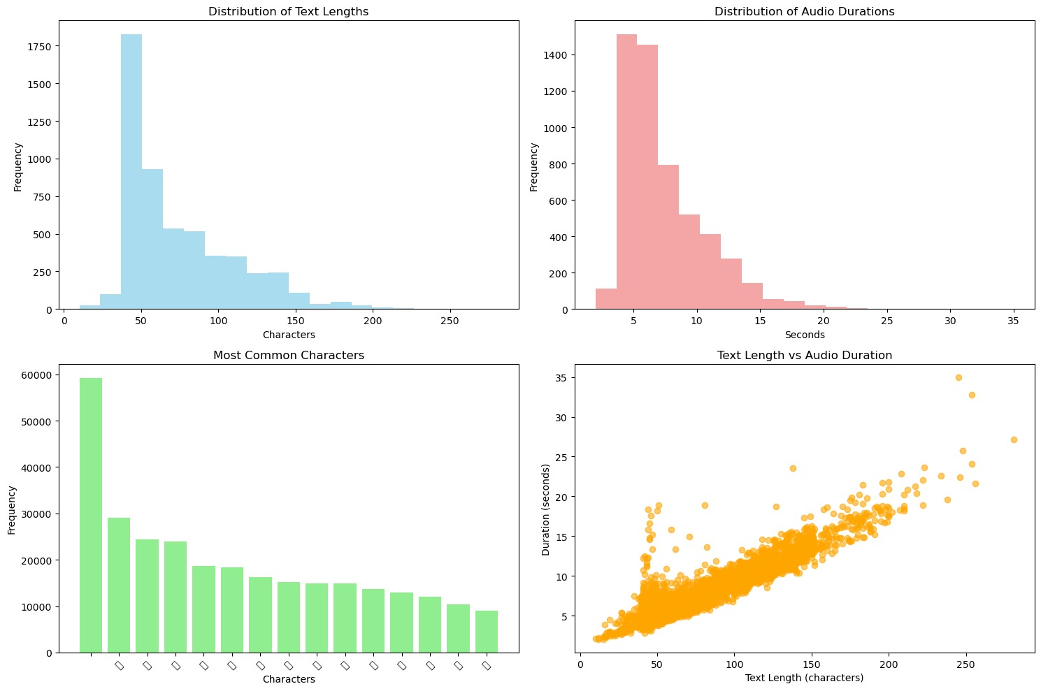
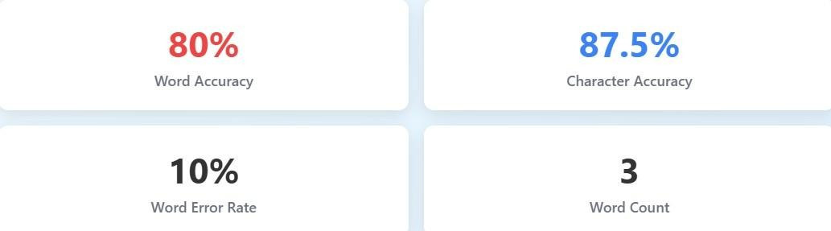
Model Results
Model speech to text identification result in 80% accuracy
build a web interface to analyze the model performance
Able to record using mic and give a audio clip

Slide 14
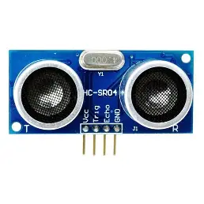
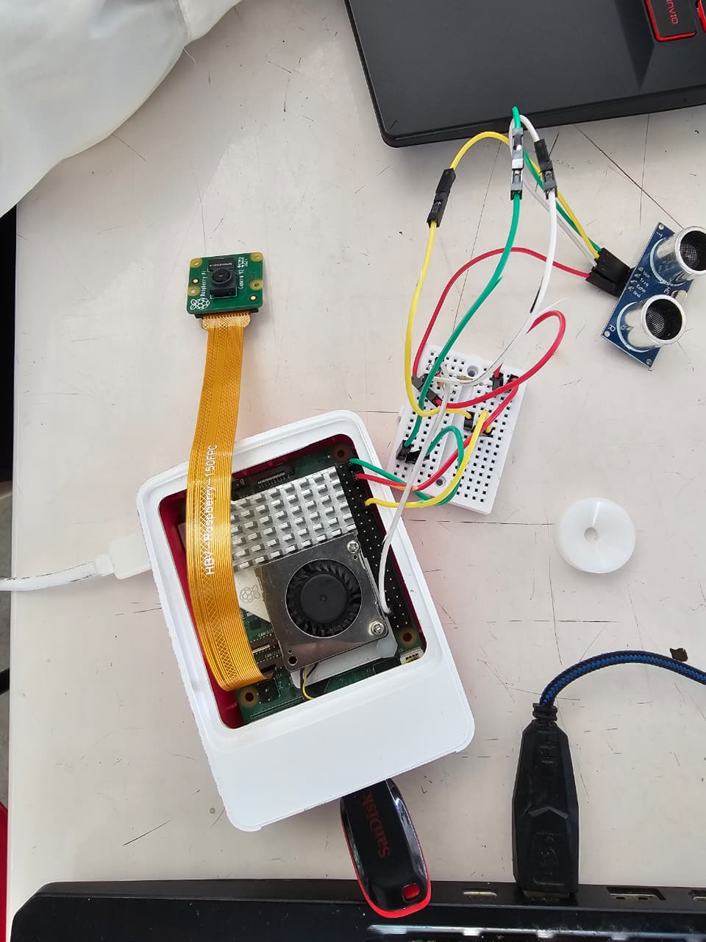
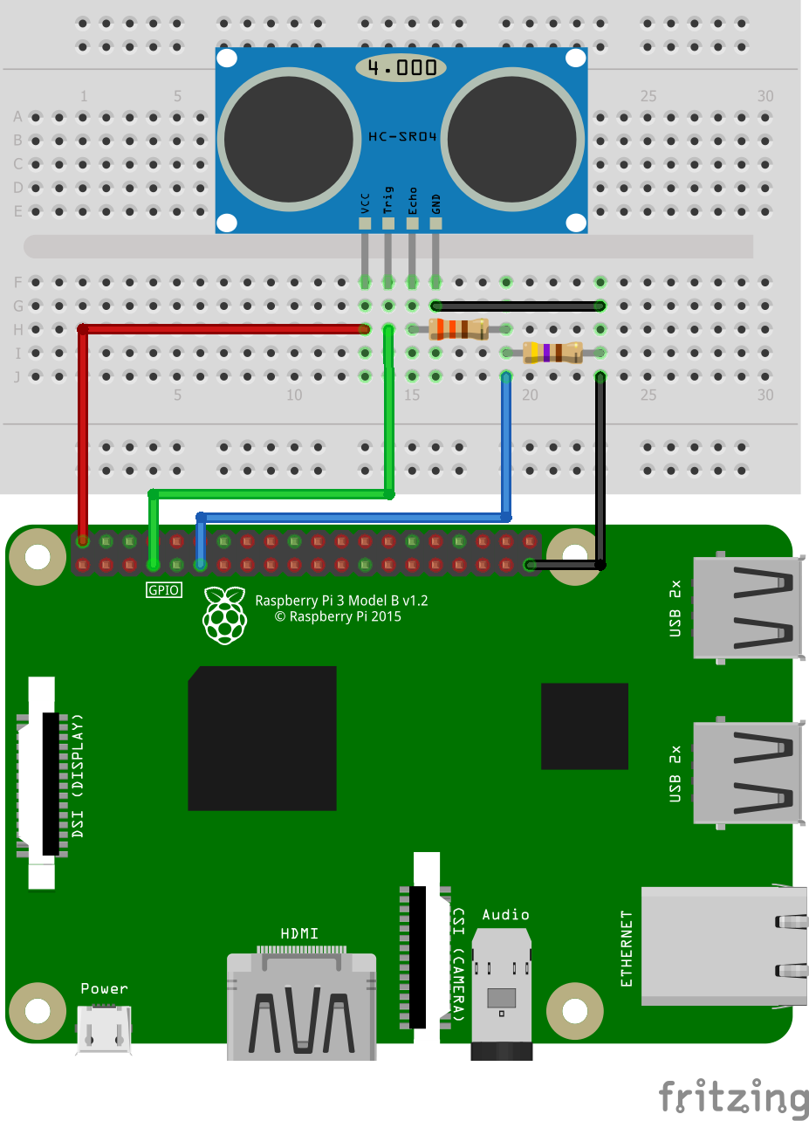
Ultra sonic Sensor
Used lightweight sensor to get the distance
Alert if object is closer with voice command

Slide 15
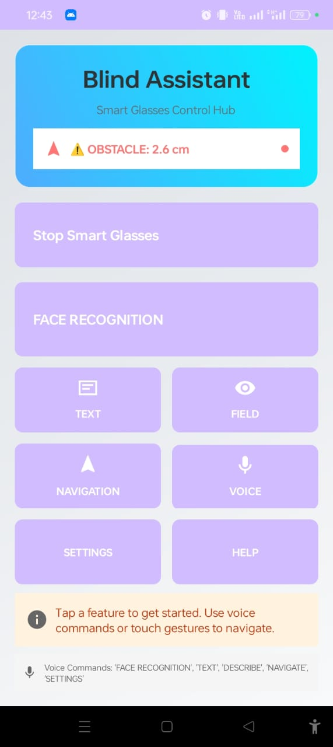
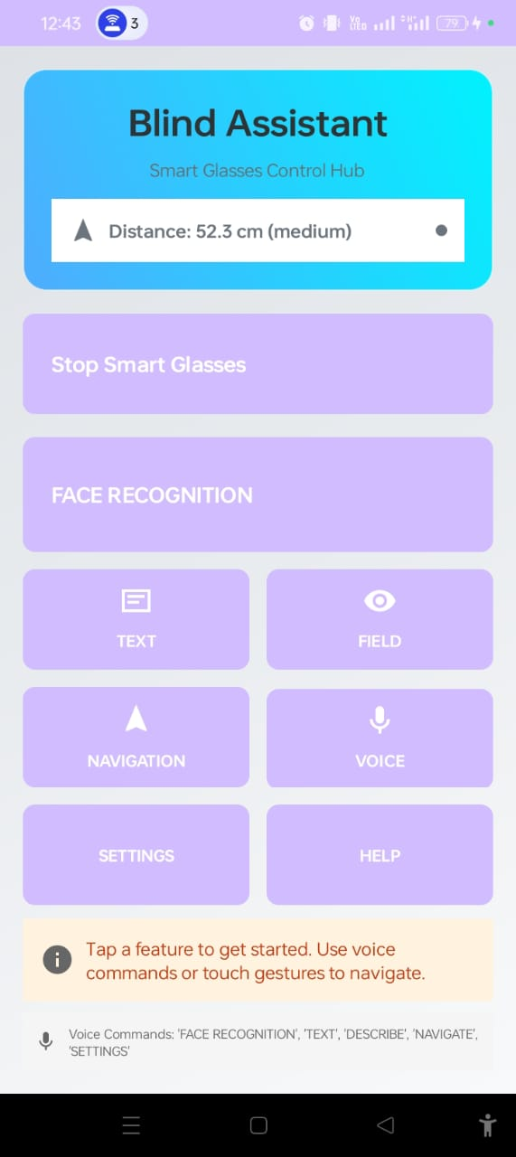
Android app interface

Slide 16
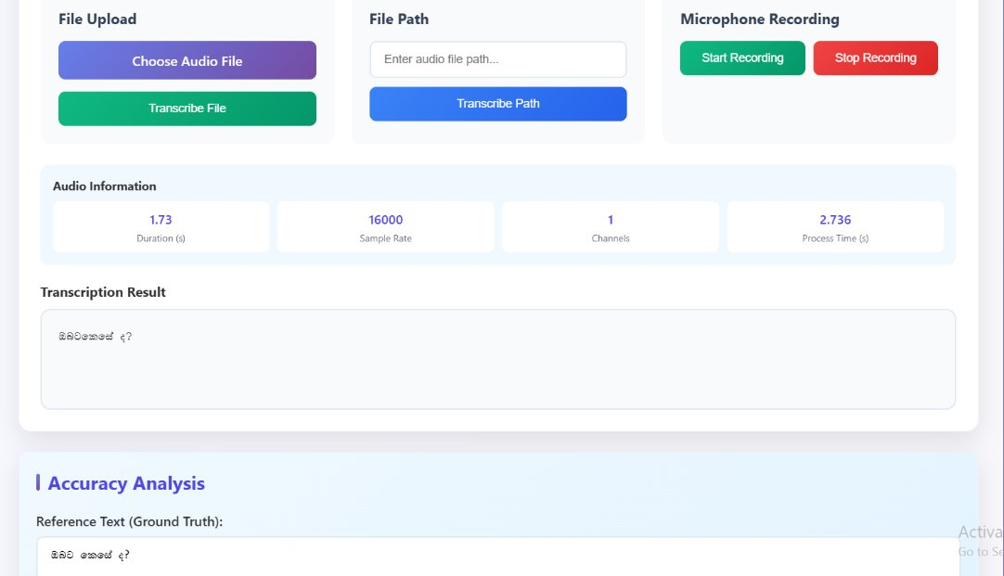
Discussion
STT Web ui for accuracy evaluation
Sinhala Speech-to-Text (STT) model trained from scratch using public dataset.
Ultrasonic sensor circuit designed & integrated with microcontroller + Android app for real-time obstacle detection.
Android app used Text-to-Speech (TTS) for voice feedback & command interaction.
System deployed on microcontroller (edge device) for low-latency, offline processing.
Modular Android app sections developed for voice commands, alerts, and system control.

Slide 17
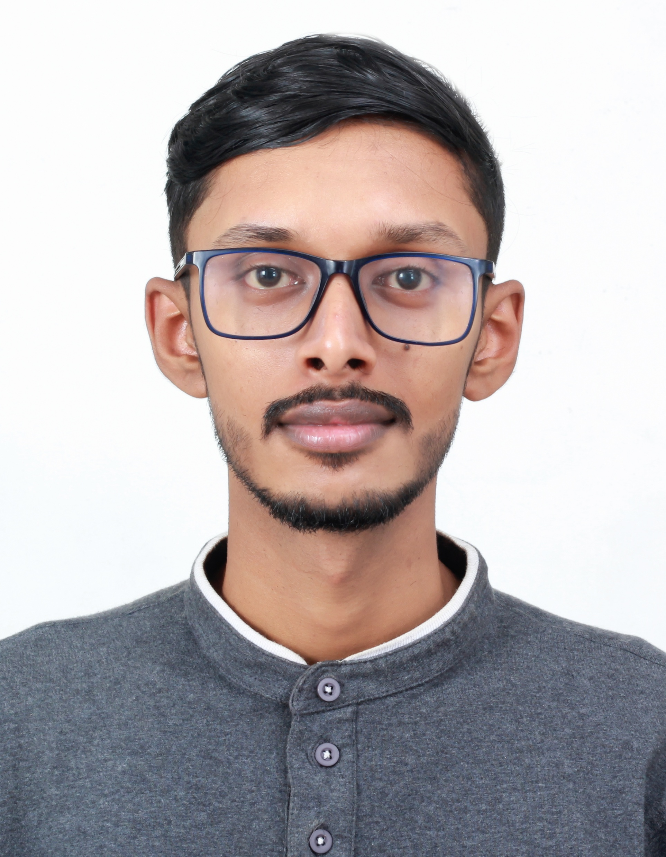
IT21820946 | Rayan Weragala
BSc (Hons) Degree in Information Technology (specialization in Information Technology)

Slide 18
IT21820946 – Weragala R.T.L
Real-time Face Recognition Optimized Flask server on Raspberry Pi with TensorFlow Lite for fast, low-power inference.
Seamless Mobile Integration Android app captures ~10 frames/sec, preprocesses & filters images, and transmits only high-quality frames to the server.
Smart Enrollment via Voice Hands-free voice-command feature to register new individuals quickly and accurately.
Edge AI for Privacy & Cost-Efficiency Runs completely offline on Raspberry Pi, ensuring data privacy and reducing infrastructure cost.
Automated & Reliable Deployment Flask server auto-starts on boot with robust error recovery for continuous operation.

Slide 19
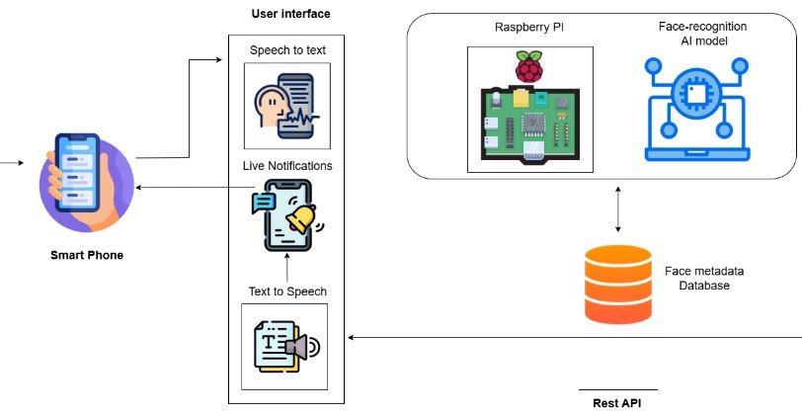
Overall System Diagram

Slide 20

Novelty & Contribution
Edge-first Design – Unlike traditional face recognition that depends on heavy cloud servers, your system runs fully on Raspberry Pi with TinyML.
Low-resource Optimization – Works reliably on limited computing power while still maintaining real-time recognition.
Integrated Voice Control – Novel hands-free enrollment mechanism, making it accessible for visually impaired or non-technical users.
Hybrid Architecture – Android app does preprocessing + quality filtering, reducing server load and improving accuracy.

Slide 21

Why is this important?
Privacy-Preserving – Faces are processed locally, no sensitive data leaves the device.
Low-Cost Solution – Eliminates need for expensive GPUs or cloud subscriptions → affordable for schools, small businesses, assistive tech.
Scalability – Can be deployed in remote areas with limited internet connectivity.
Accessibility Impact – Voice-based registration and recognition support inclusion for blind or differently-abled users.

Slide 22
Challenges & Solutions
1. Raspberry Pi Camera Setup
Challenge: Limited guidance for configuring the new Pi camera; multiple failed installations.
Solution: Researched and tested different configurations until stable setup achieved.
2. High Memory Usage (RAM)
Challenge: Processing many frames per second overloaded Pi memory.
Solution: Implemented thread-based cleaning mechanisms to free memory continuously.
3. Image Quality Issues
Challenge: Camera produced blur, color distortion, and poor white balance.
Solution: Applied preprocessing (sharpening, color correction, blur detection) before recognition.
4. Model Sensitivity
Challenge: Recognition failed if only a few samples were available.
Solution: Fine-tuned system with multi-image registration (5–20 images), improving recognition across lighting and color variations.
5. Networking Problems
Challenge: Server conflicts and no static IP in shared network.
Solution: Used a mobile hotspot to create a dedicated network for Pi, laptop, and phone.

Slide 23
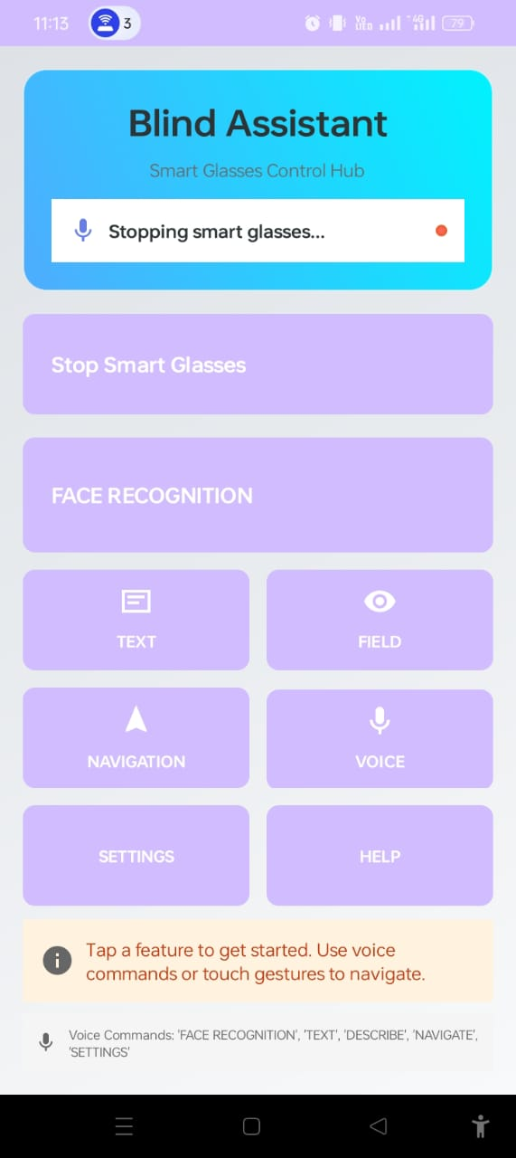
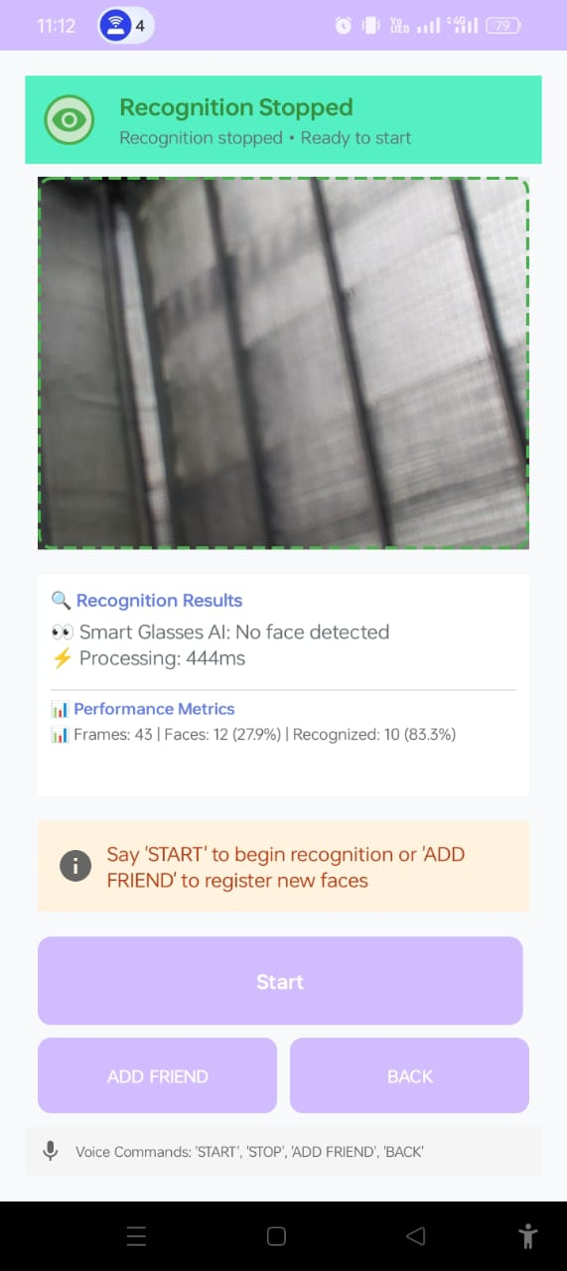
Screenshots & System design
System design
Mobile app screenshots

Slide 24
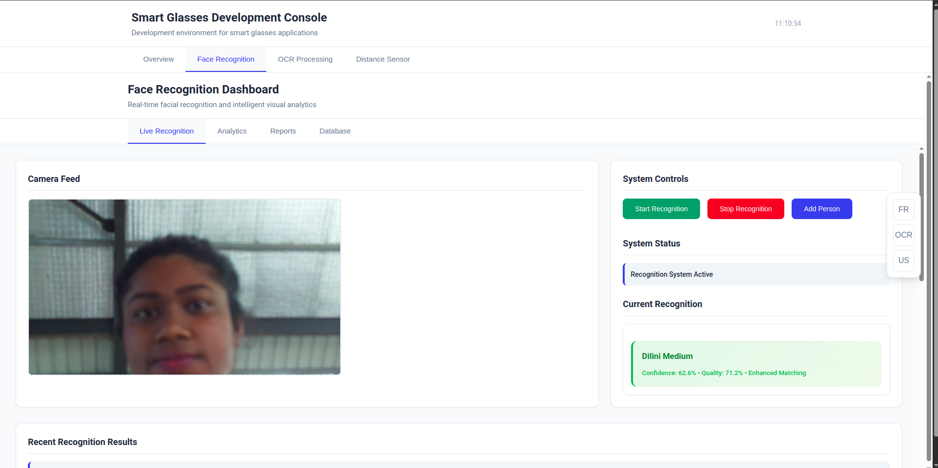
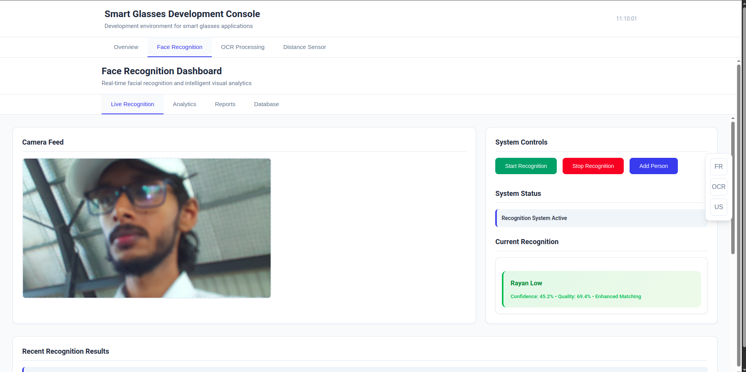
Screenshots & System design

Slide 25
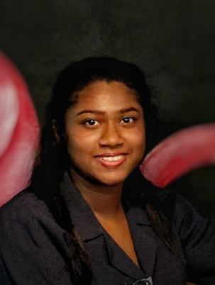
IT21826740 | K.D. Dilini
BSc (Hons) Degree in Information Technology
(specialization in Information Technology)
Sinhala Text Recognition
and
Document Identification

Slide 26
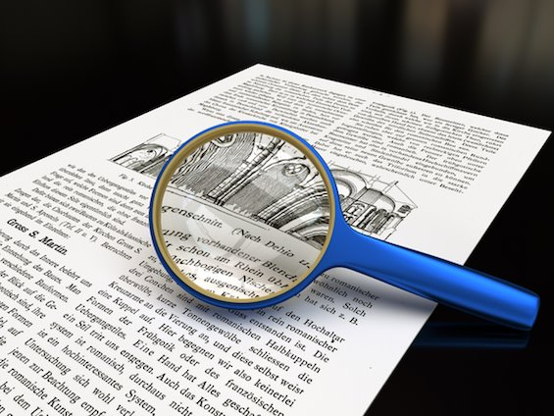
Background and Literature
“OCR and TTS help people worldwide, but Sinhala OCR is still underdeveloped because of its complex script and lack of real-time tools. Current research only has prototypes, not affordable mobile solutions. Our study builds a TinyML and Edge AI–based Sinhala OCR with TTS and document classification to support visually impaired users.”

Slide 27
Research Problem and Objectives
Research Problem -
Visually impaired individuals in Sri Lanka lack affordable, real-time, wearable Sinhala OCR solutions. Existing tools face challenges of script complexity, internet dependency, and cost, creating a need for lightweight, offline, Edge AI–based assistive technology.
Objective -
The objective is to develop affordable smart glasses integrating Sinhala OCR, document identification, and real-time TTS using Edge AI and TinyML. This system empowers visually impaired individuals in Sri Lanka with independent, offline access to printed materials and improved reading accessibility.

Slide 28
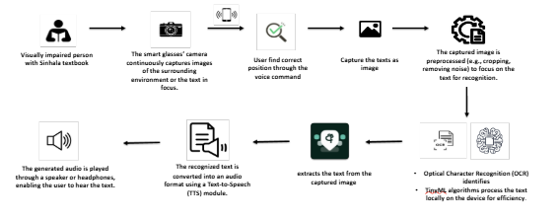
Methodology and System Diagram
The methodology involved designing a smart glasses–based assistive system integrating Tesseract OCR 5.5.0, Sinhala TTS, and document classification. A Raspberry Pi camera captured text, processed through a mobile app, while a custom 18,000-image dataset trained MobileNetV2 for classification

Slide 29
Possible solution
Several approaches were explored to improve Sinhala OCR accuracy, including EAST, CRAFT, and EasyOCR, along with creating a custom line-level dataset(10989) and experimenting with character-level pretraining using Kaggle data. Fine-tuning older Tesseract models with its training tool was also attempted. Despite these efforts, high accuracy was not achieved, so Tesseract OCR was adopted, providing medium-level accuracy. For document classification, a dataset of six classes (3,000 images each) was trained over 50 epochs, achieving ~90% accuracy.

Slide 30
Developed solution
Custom Dataset:
18,000 images created across six classes – exam papers, newspapers, forms, notes, stories, and words.
Document Classification:
Achieved high accuracy using MobileNetV2 transfer learning with data augmentation.
Sinhala OCR:
Integrated Tesseract OCR 5.5.0 for reliable text extraction.
️ Edge Deployment:
System deployed on Raspberry Pi smart glasses and connected mobile app.
Assistive Features:
Real-time Sinhala text recognition, text-to-speech feedback, offline functionality, and hands-free usability for visually impaired users.

Slide 31
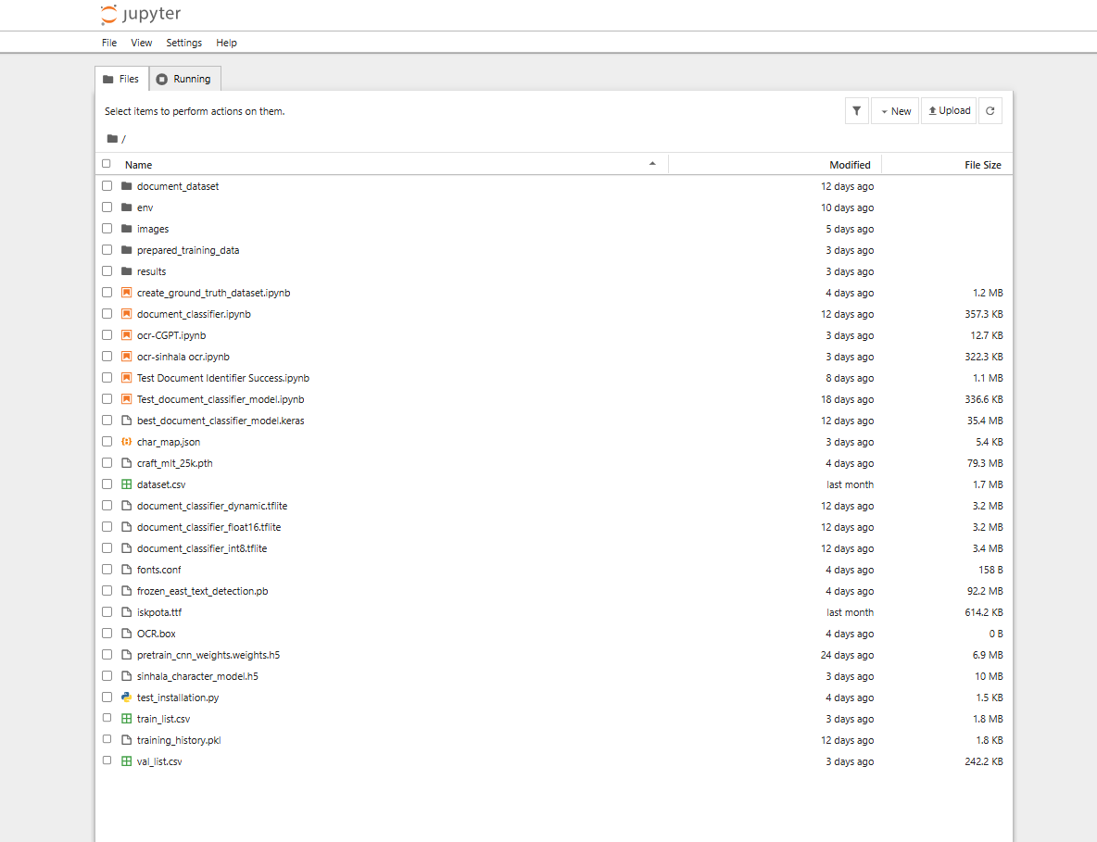
Results and Discussion
Model Training Folder Structure

Slide 32
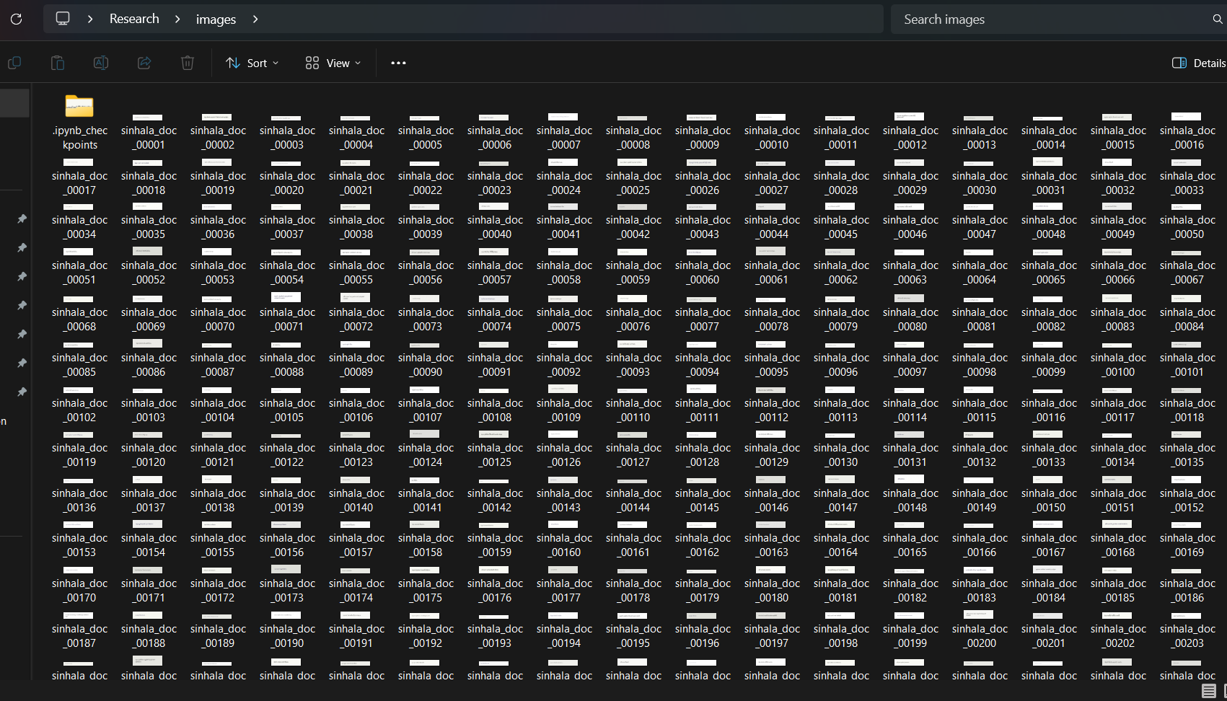
Evidence of completion
Model train folder structure
Document Identification Dataset Creation
A total of 18,000 images were collected, with 3,000 samples for each document class.

Slide 33
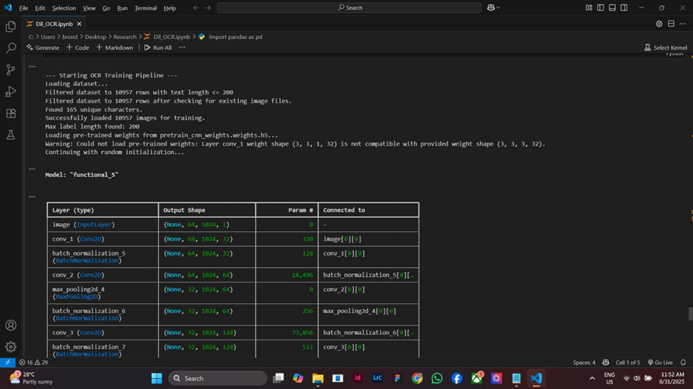
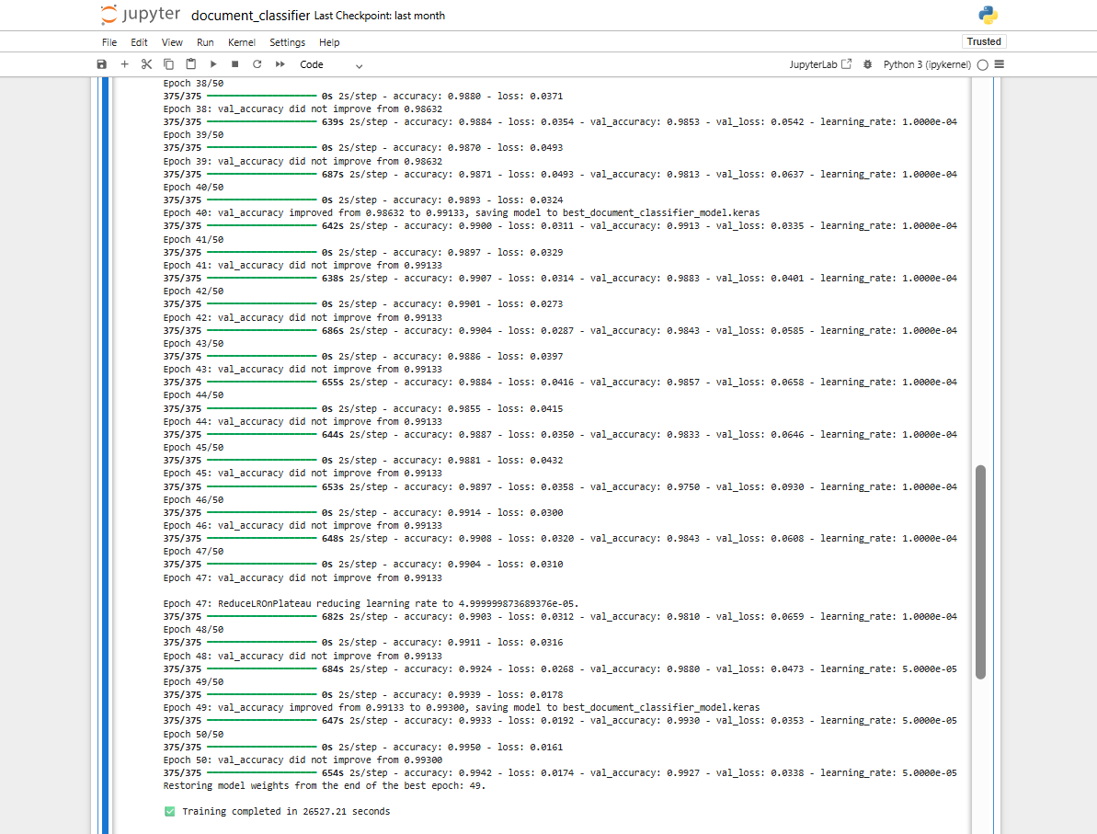
Load OCR Dataset
proofed of model create

Slide 34
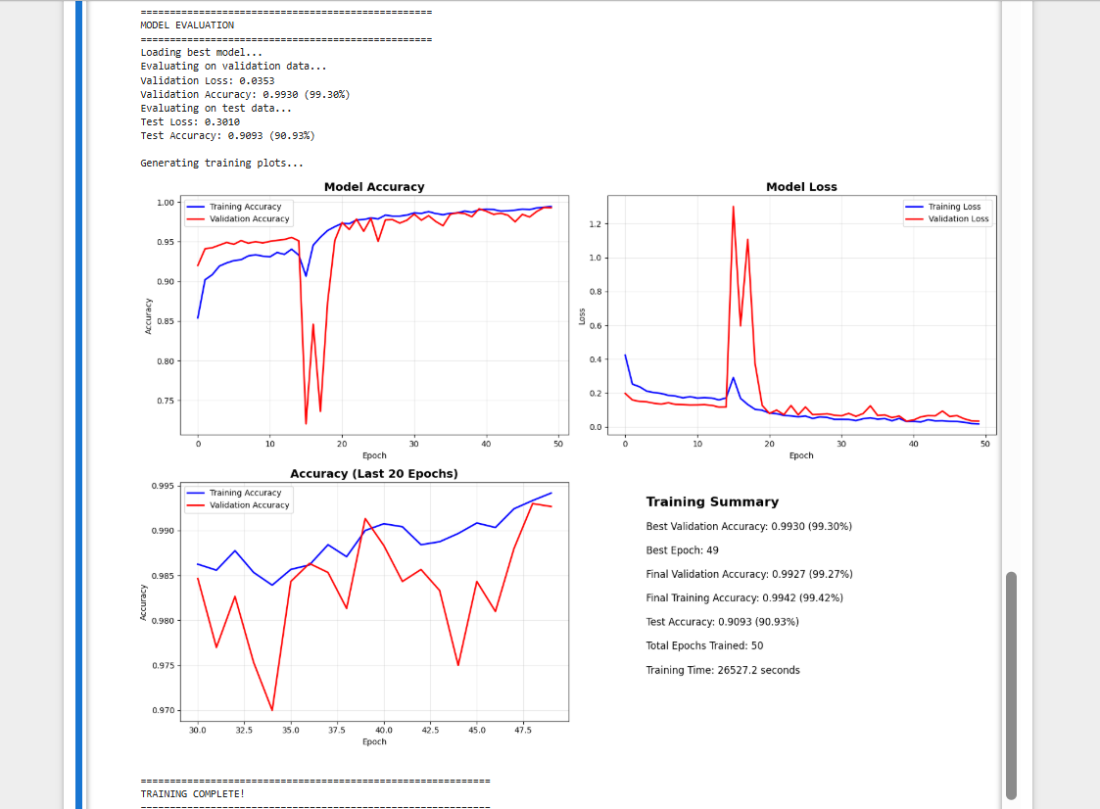
Evaluation of Document classification
proofed of model create

Slide 35
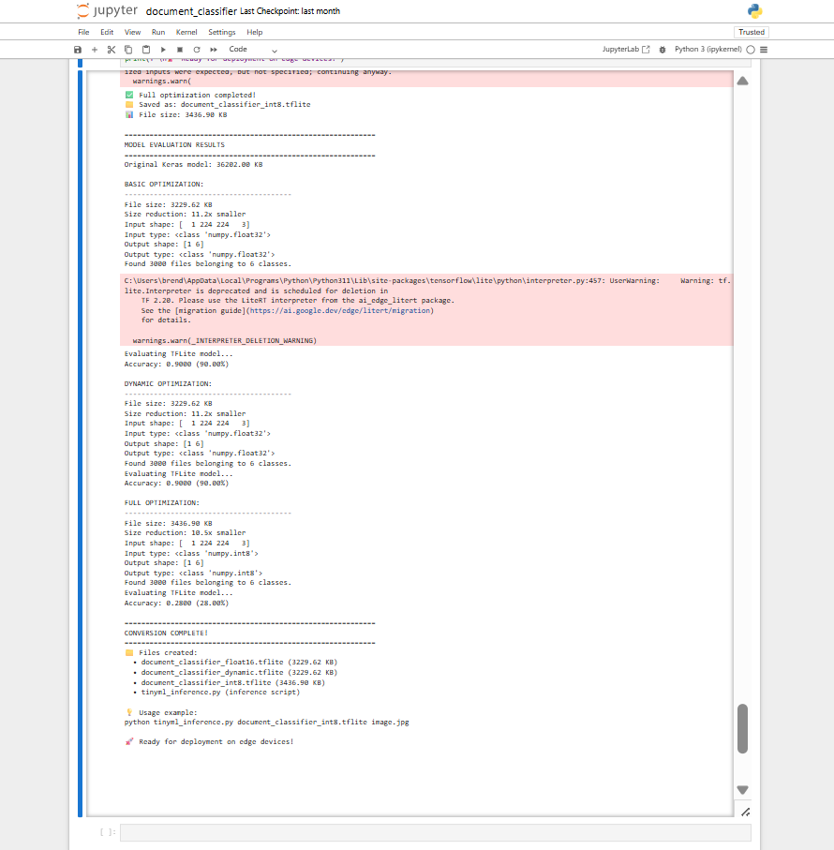
Evaluating TinyML Model of Document classification

Slide 36
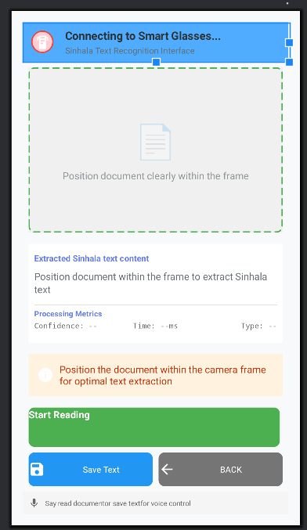
Mobile Application
Interface

